Slide 1


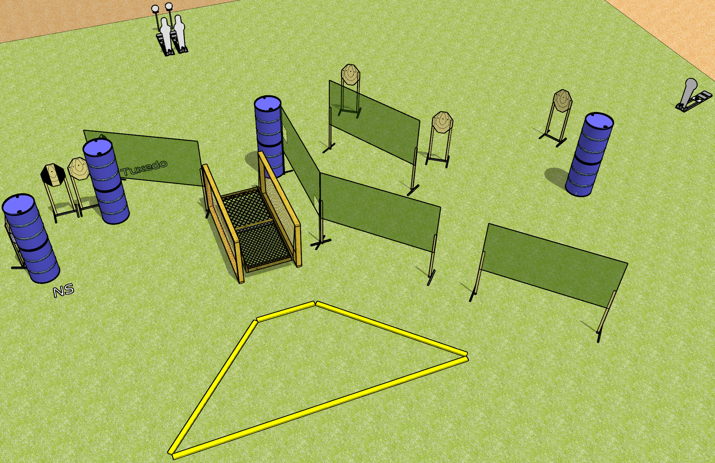
 | Dothan Gun Club – USPSA Match Wobbly Knees Course Designer : Drew Coleman
Round Count 19 rounds 7 IPSC 2 pepper poppers, 1 colt popper, 2 falling plates
Equipment List Bridge 10 wall feet 1 medium fault line. 2 tuxedos

Slide 2
Wobbly Knees
Written Stage Briefing
Wobbly Knees is a 19 round, 95 point, Comstock course of fire. There are 7 IPSC targets, 2 pepper poppers, 1 colt popper, and 2 falling plates. The best 2 hits on paper will score, and steel must fall to score. The start signal is audible.
The railing on the bridge is NOT part of the shooting area and cannot be used for support while firing. The platform itself is part of the shooting area.
Handgun start position is one foot inside, one foot outside of the shooting area, not touching a fault line, wrists below belt. Handgun is loaded and holstered.
PCC start position is one foot inside, one foot outside of the shooting area, not touching a fault line. Loaded carbine is held with both hands, stock on belt, safety on.
On start signal, engage targets as they become available from within the shooting area.

